Slide 1
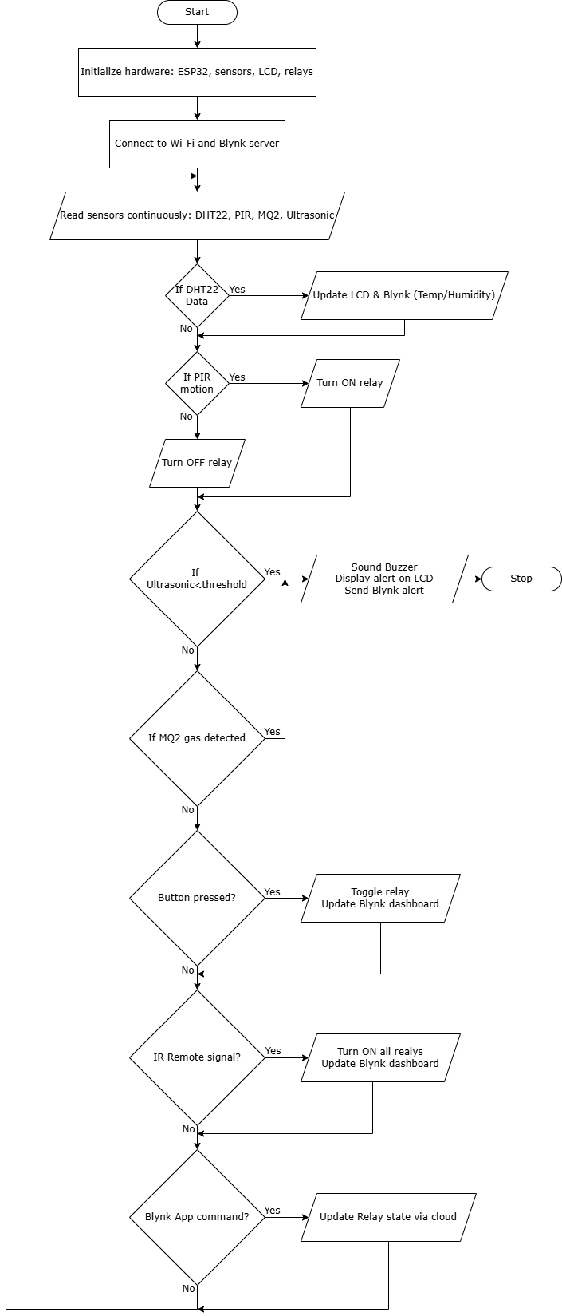
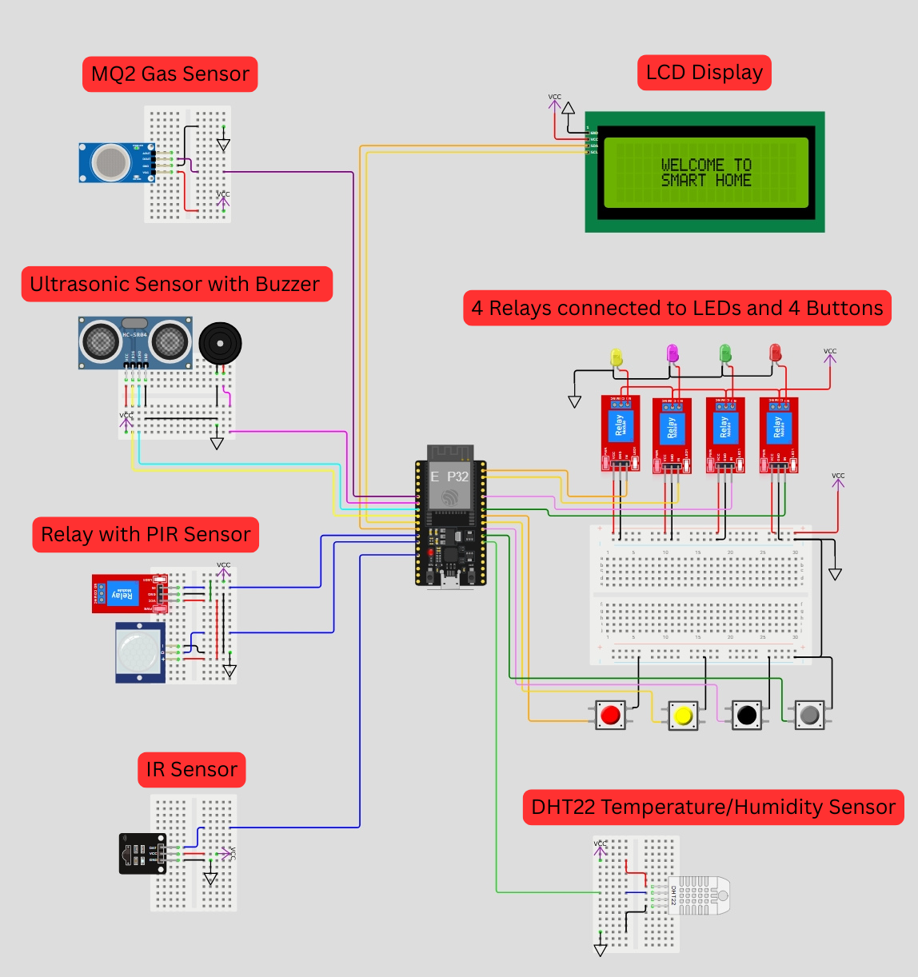
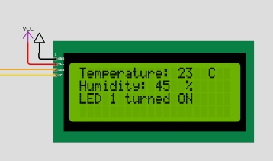
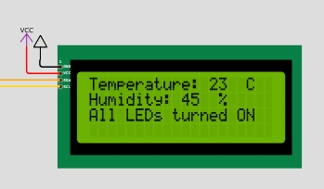
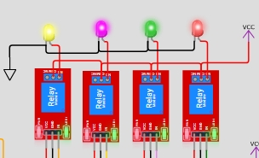
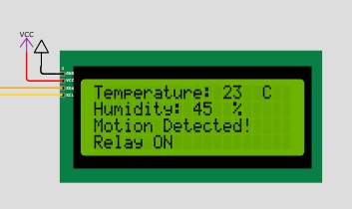
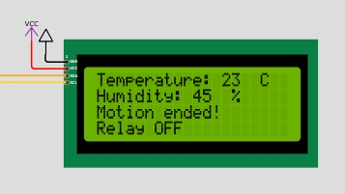
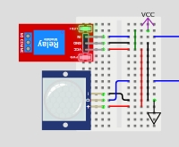
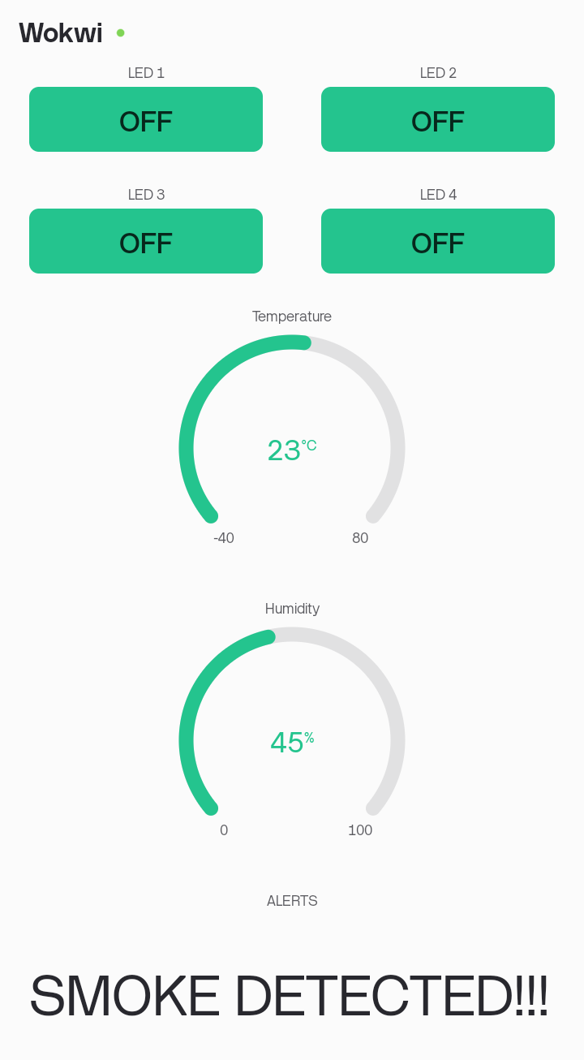
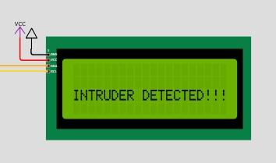
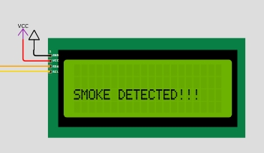
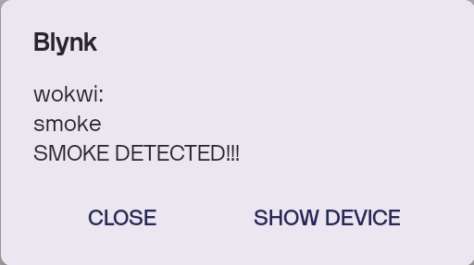
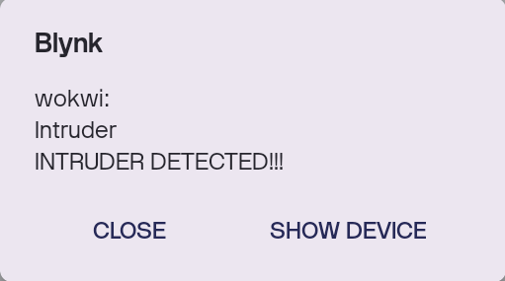

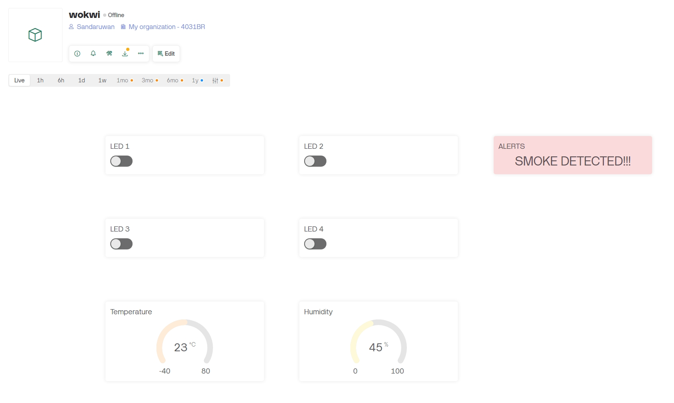
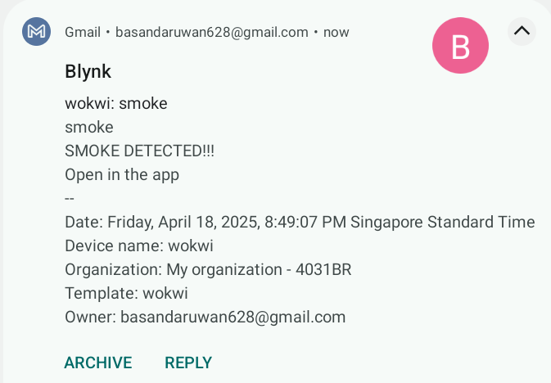
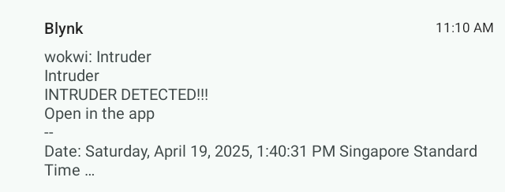
IoT-Based Smart Home Automation Using Blynk
B.A.S. SANDARUWAN, A.V.N. PERERA, C.E. RAJAKARUNA, U.D.R. NIKESH
EEY4181/EEY4182/EEY4183, GROUP PROJECT, 2022/2023
Introduction
Modern homes require efficient automation to enhance comfort, security, and energy savings.
Manual control of appliances is inconvenient and leads to energy wastage.
Lack of real-time monitoring of environmental conditions (temperature, humidity, gas leaks) can pose safety risks.
Traditional security systems are expensive and may not provide instant alerts.
Methodology
Design
Key Components
ESP32 Microcontroller
Relays
Sensors:
  DHT22: Temperature and humidity sensor
  PIR: Detects motion
  Ultrasonic: Measures distance
  IR sensor
  MQ2: Detects smoke
User Interfaces:
  Blynk Web interface
  Blynk mobile application
LCD (20x4 I2C): Displays data
IR Remote: Remote control
Push Buttons
Buzzer: Alarm for security (intruder/gas detection)
Simulator Used: WOKWI ESP32 Simulator
Results
Aim & Objectives
Aim:
To design and implement a smart home automation system using an ESP32 microcontroller that enhances convenience, security, and energy efficiency through sensor-based automation and remote control.
Objectives:
Control relays via manual buttons, Blynk app, and IR remote for flexible operation.
Enable motion-activated lighting using a PIR sensor.
Measure and display temperature & humidity using a DHT22 sensor on an LCD and Blynk dashboard.
Detect gas/smoke leaks with an MQ2 sensor and trigger an alarm for safety.
Implement an ultrasonic sensor-based alarm.
Display system status on an LCD screen.
Conclusion
This Home Automation project successfully integrates IoT control, sensor monitoring, and multi device management to create a versatile, user-friendly smart home solution. By combining Wi-Fi (Blynk), IR remote, and manual push-button controls, the system ensures flexibility in operation, while real-time feedback via an LCD and Blynk app enhances user interaction.
Acknowledgements
We extend our gratitude to Ms. Poorni Abayarathna for her invaluable role as our supervisor, providing guidance, feedback and support throughout this project.
22 . 04 . 2025

